Slide 1
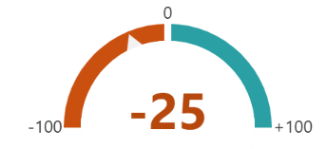
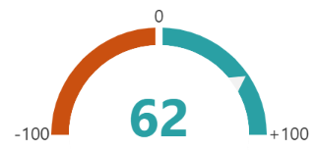
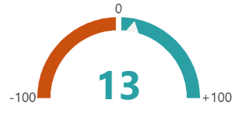
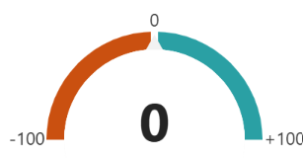
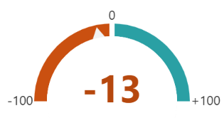
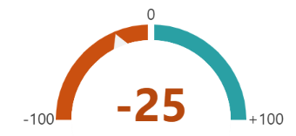
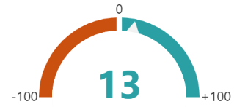
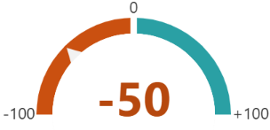
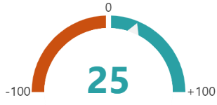
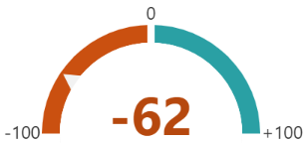
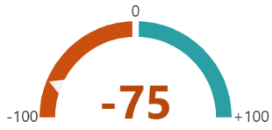
Topic | +0- | Score
ELNs | 2-2-4
P-hacking HARKing Publication Bias | 6-1-1
Randomization Blinding Sample Size | 3-3-2
Pre-registration Registered Reports | 4-0-4
Replication Study Pt 1 | 2-3-3
Replication Study Pt 2 | 2-2-4
Tidy Data | 3-3-2
Version Control | 1-2-5
Data Management Plan | 4-2-2
Checklists, Minimum Information, SOPs | 1-1-6
Authentication of resources | 0-2-6
IMG
1
3
5
4
2

Slide 2
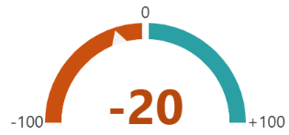
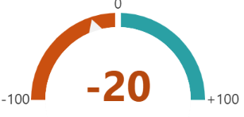
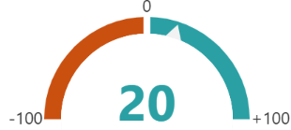
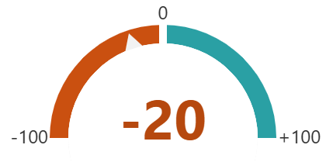
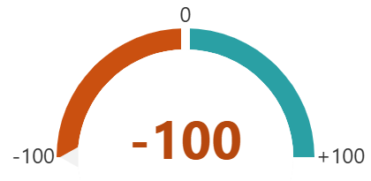
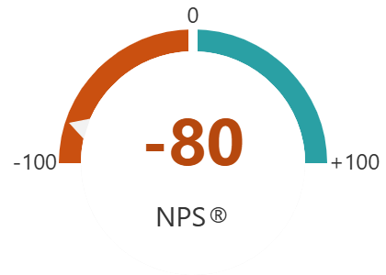
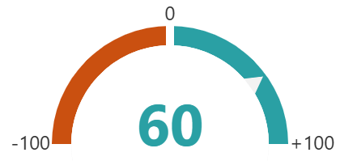
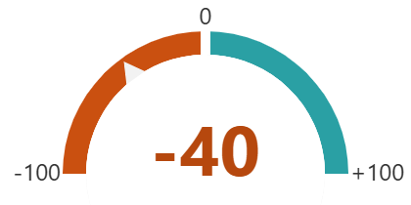
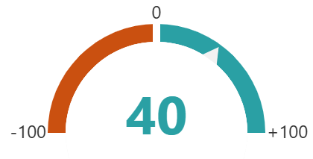
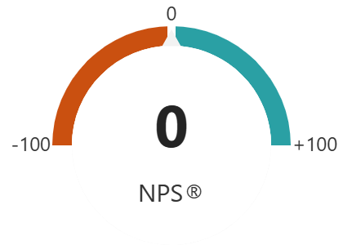
Topic | +0- | Score
ELNs | 1-2-2
P-hacking HARKing Publication Bias | 1-2-2
Randomization Blinding Sample Size | 2-2-1
Pre-registration Registered Reports | 1-2-2
Replication Study Pt 1 | 0-0-5
Replication Study Pt 2 | 1-0-4
Tidy Data
Version Control
Data Management Plan
Checklists, Minimum Information, SOPs
Authentication of resources
IPHYS
5
3
1
2
4

